Slide 1


Python Programming Summer Camp
Class # 7
Build an Application from Scratch
By Asim Munawar

Slide 2

Course Plan
Lesson 1: Printing Fun – Say Hello to Python
Lesson 2: Variables – Remembering Things in Code
Lesson 2: If/Else – Making Decisions
Lesson 3: Loops – Doing Things Again and Again / Inputs
Lesson 4: Lists – Collecting Many Things
Lesson 5: Functions – Teach the Computer a New Trick
Lesson 6: Libraries - Using Functions written by others
Files – Saving and Reading Data
Lesson 7: Build an application from scratch
Lesson 8: Final Project – Build and Present Your App

Slide 3

Steps of creating a new App
💡 Think of an Idea
What problem do you want to solve?
Who will use the app?
Example: “I want to make a Homework Tracker to help kids remember assignments.”
✏️ Draw or Write Pseudocode
Write your plan in simple, human language (not real code yet!)
Example:
Start
Ask user for subject
Ask user for homework
Save info in list
Show all saved homework
End
🧠 Write the Algorithm
What are the exact steps your app needs to follow?
Example:
Ask user for today's homework
Save it to a file
Show all homework when asked

Slide 4
Steps of creating a new App
🔧 Pick Python Features You'll Use
✅ print() – to show messages
✅ input() – to take answers from user
✅ lists – to store many homework entries
✅ functions – to organize tasks
✅ file – to save and load data
🧪 Test and Improve
Try out your app
Fix any bugs
Add bonus features (colors, emojis, sorting)
🎉 Show It Off!
Save your final code
Share it with family or friends
You’re now an app developer!
👨‍💻 Start Coding in Python
Start small: test each step as you go
Build the app in pieces using your pseudocode

Slide 5
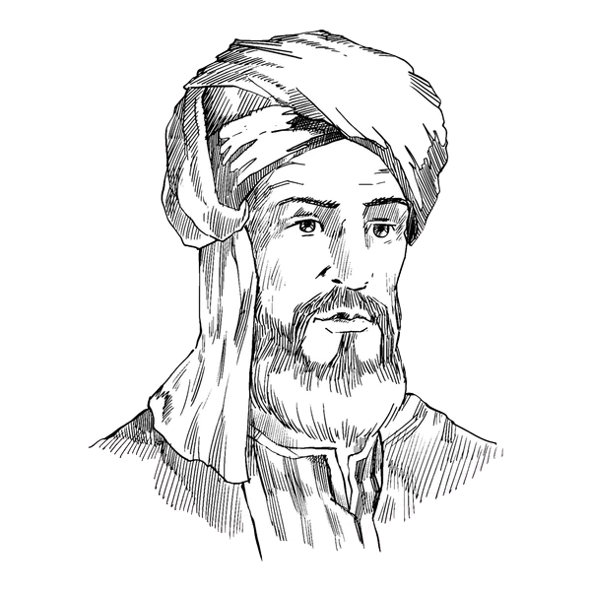
What is an Algorithm?
An algorithm is a step-by-step set of instructions to solve a problem or complete a task. Just like a recipe in cooking!
Example:
How to brush your teeth:
Pick up your toothbrush
Put toothpaste on it
Brush for 2 minutes
Rinse!
A Bit of History
The word “algorithm” comes from the name of a Persian Muslim Mathematician, Al-Khwarizmi (from the 800s!)
He wrote a famous book about solving math problems using clear steps — like early coding!

Slide 6

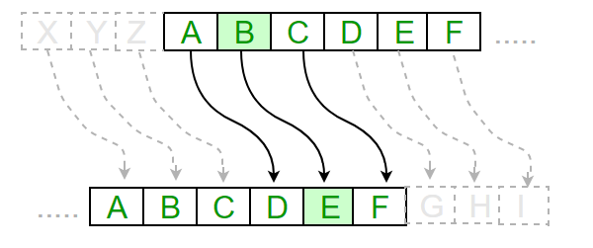
Secret Message App
A program that encodes a message (e.g., using a Caesar cipher), saves it to a file, and shares it. A classmate can open the file and decode it using their own program.

Slide 7
Algorithm
Pseudocode
✍️ To Hide a Message:
Type your message.
Pick a secret number.
Move each letter forward by that number.
Save it in a file.
🔓 To Read a Message:
Open the file.
Type the secret number.
Move each letter backward by that number.
Show the real message.
Welcome to Secret Message App!
What do you want to do?
1. Encode a message
2. Decode a message
3. Exit
If 1:
Ask user to type a message
Ask for a secret number (key)
Shift each letter by that number (A→D if key=3)
Save the result to a file
If 2:
Ask for file name
Read the message
Ask for the key
Shift letters back by that number
Show original message
Repeat until user chooses Exit

Slide 8

Python Features to Use

Slide 9
🕵️‍♂️ Fun Facts About Secret Codes & Encryption
Caesar Made It Famous
The code you're using (shifting letters) is called the Caesar Cipher — named after Julius Caesar, who used it over 2,000 years ago to send secret messages to his army!
There are only 25 different secret numbers (keys) in this code.
World War II Spies
During World War II, spies and soldiers used special machines (like the Enigma machine) to make super tricky secret messages that even computers had a hard time cracking.
Your Phone Uses Encryption
Every time you send a message on WhatsApp or play an online game, your phone is secretly using super powerful encryption to keep your info safe!
Emojis as Code?
Some people today create secret codes using emojis instead of letters! 🤫🔒➡️😁

Slide 10
abc = "abcdefghijklmnopqrstuvwxyz"
def encode(message, secret_number):
result = ""
for letter in message.lower():
if letter in abc:
old_index = abc.index(letter)
new_index = (old_index + secret_number) % 26
result += abc[new_index]
else:
result += letter
return result
def decode(message, key):
return encode(message, -key)
Encode
Decode

Slide 11
Save and Load File
def save(message):
filename = input("Enter filename to save (like secret.txt): ")
with open(filename, "w") as file:
file.write(message)
print("✅ Message saved to", filename)
def load():
filename = input("Enter filename to open: ")
with open(filename, "r") as file:
return file.read()

Slide 12
while True:
print("\n🔐 Secret Message App")
print("1. Encode a message")
print("2. Decode a message")
print("3. Exit")
choice = input("Pick 1, 2, or 3: ")
if choice == "1":
text = input("Type your message: ")
key = int(input("Pick a secret number (1–25): "))
secret = encode(text, key)
print("🕵️‍♂️ Your secret message is:", secret)
save(secret)
elif choice == "2":
secret = load()
key = int(input("What is the secret number? "))
message = decode(secret, key)
print("💬 The real message is:", message)
elif choice == "3":
print("👋 Bye!")
break
else:
print("❗Please type 1, 2, or 3.")
Main Logic

Slide 13


Thank You

